Slide 1
Lt. Cmdr Daniel Rojas Contreras
IHO – NIPPON FOUNDATION
ALUMNI SEMINAR

Slide 2
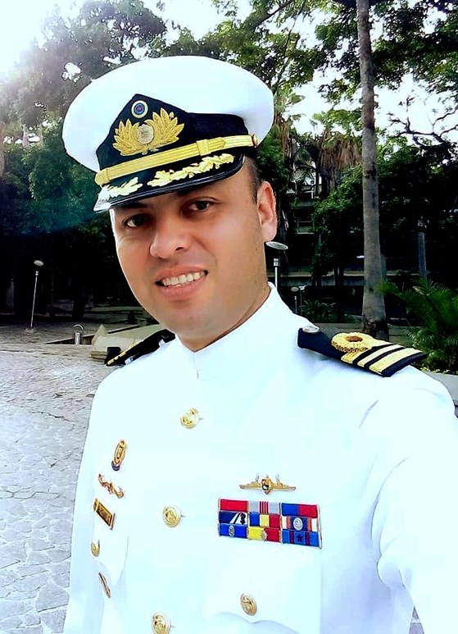
Self introduction
IHO – NIPPON FOUNDATION
ALUMNI SEMINAR
Name | Daniel Rojas Contreras
Alumni year | 2017
Country | Bolivarian Republic of Venezuela
Organization | Venezuela Hydrographic Office
Position/Job title | Head of Department of Marine Cartography and Notice to Mariners
Current job description | head of production and editing of ENC and paper charts and disclosure of notice to mariners
Please put your photo here!

Slide 3
My career path and projects / Achievements
IHO – NIPPON FOUNDATION
ALUMNI SEMINAR
Venezuelan Navy officer with 17 years of experience.
on-board officer, performing in the area of fleet operations.
Venezuelan Coast Guard Patrol Commander.
Hydrography Specialist.
For the last 5 years I have been as Head of Cartography in the Hydrography Service of Venezuela.
ENC coverage from 0% in 2016 to 100% in 2019.
92 Venezuelan cells in distribution.
edition and validation of 24 cells for the Orinoco River navigation project.
modification of the INT chart scheme, at the request of the MACHC.
Certification of competence and experience CAT B in Marine Cartography and Data Assesment in March 2019

Slide 4
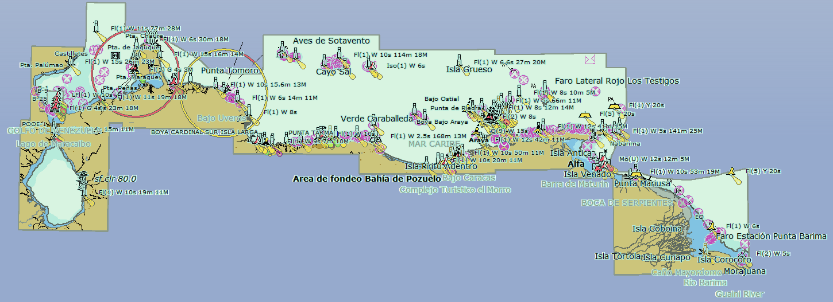
My career path and projects / Achievements
IHO – NIPPON FOUNDATION
ALUMNI SEMINAR
100% coverage
92 cells in distribution

Slide 5
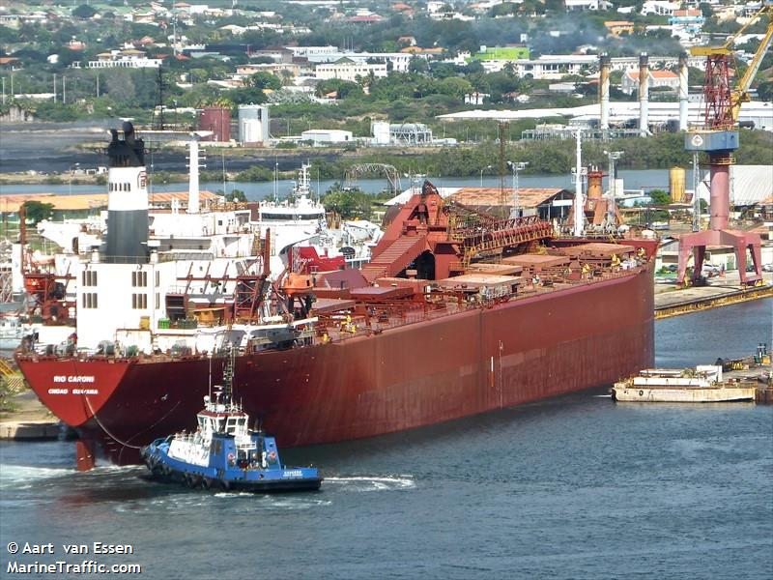
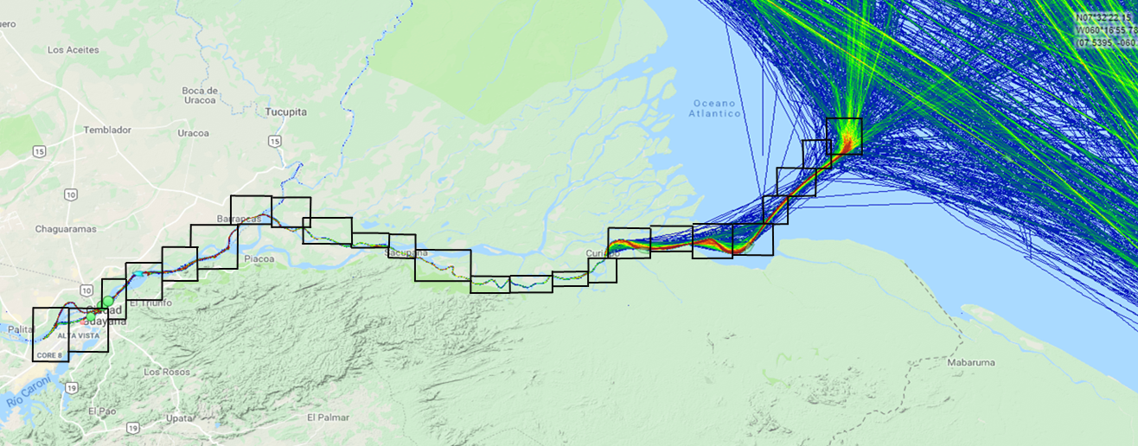
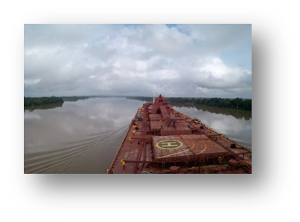
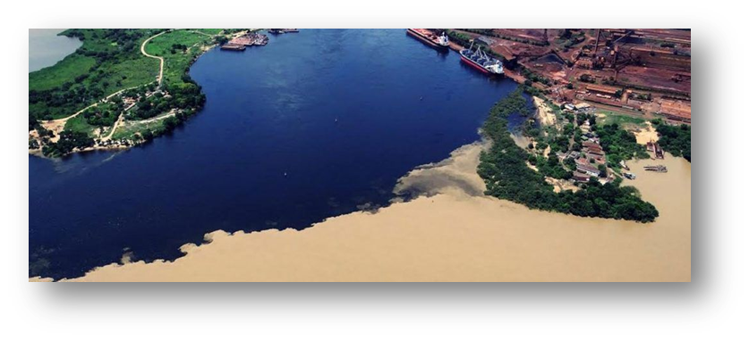
My career path and projects / Achievements
IHO – NIPPON FOUNDATION
ALUMNI SEMINAR
edition and validation of 24 cells for the Orinoco River navigation project

Slide 6
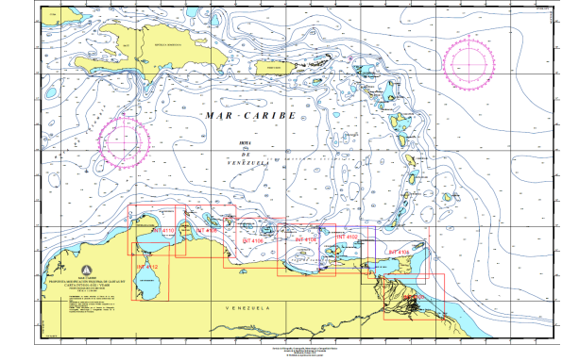
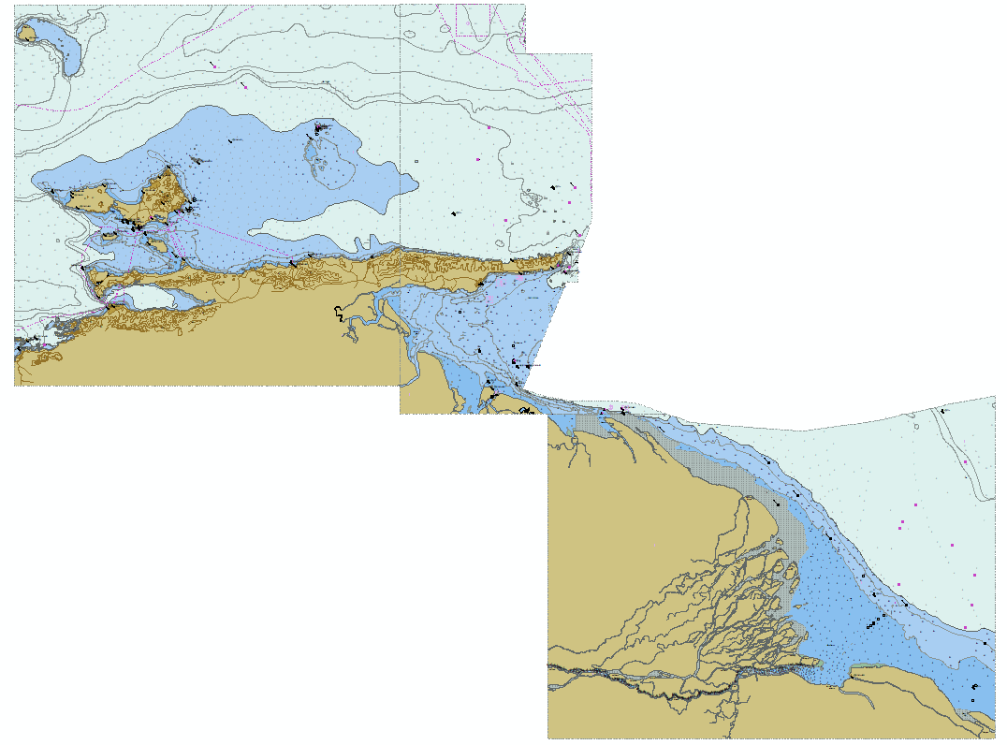
My career path and projects / Achievements
IHO – NIPPON FOUNDATION
ALUMNI SEMINAR
INT 4101
INT 4102
INT 4100
Modification of the limits of the chart INT4100,INT4101, INT4102
This modification aims to resolve the information gap north of Trinidad and Tobago and south of Grenada
new editions of ENC band 3

Slide 7
Lessons learned from CHART Course
IHO – NIPPON FOUNDATION
ALUMNI SEMINAR
Course content is very complete.
Teachers accumulate many years of experience.
It is an interesting experience in a Hydrographic Office, with an extraordinary track record in the production of navigation paper charts and ENC.
The exchange of knowledge, experiences with other colleagues in the world is really wonderful.
But the most important thing is the friendship that we all have today around the world.

Slide 8
Suggestion for the future
IHO – NIPPON FOUNDATION
ALUMNI SEMINAR
Expansion of the project to the countries with the greatest deficiencies, we must analyze how we can help with low cost and many benefits
also prepare in the new s-100 standard, which will also allow to achieve the development of the MSDI
look for the most appropriate way to concatenate this project with SEABED 2030
Prepare to work very hard in the decade of the oceans

